Slide 1
Quantum Turbulence and Simulations of Superfluid He
4
FMFI, Comenius University in Bratislava
Jakub Bahyl
Supervisor: Doc. D.Schmoranzer, PhD. Consultant: M.J.Jackson, PhD.
Cryolab, MFF, Charles University in Prague

Slide 2
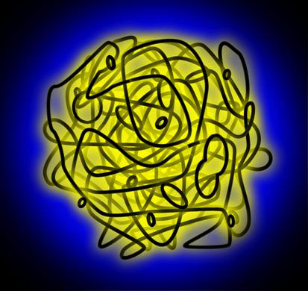
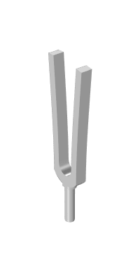
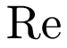

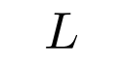
Motivation and Goals
4
Produce quantum turbulence within superfluid He
Measure and analyse quantum hydrodynamics
Simulate such processes numerically
Quantum Turbulence
Generators
Hydrodynamics
Vortex line density
Jakub Bahyl Mgr. Thesis Defense 1/29

Slide 3
Outline
Introduction to Superfluidity
Quantum Vortex & Two-fluid model
Filaments dynamics
Experimental Setup
Generation of Quantum Turbulence
Second Sound Sensors
Simulations
Graph model & Representation
Vortex Ring Segmentation
Results
Vortex line density & hydrodynamics
Correlations
Summary
Jakub Bahyl Mgr. Thesis Defense 2/29

Slide 4
Outline
Introduction to Superfluidity
Quantum Vortex & Two-fluid model
Filaments dynamics
Experimental Setup
Generation of Quantum Turbulence
Second Sound Sensors
Simulations
Graph model & Representation
Vortex Ring Segmentation
Results
Vortex line density & hydrodynamics
Correlations
Summary
Jakub Bahyl Mgr. Thesis Defense 2/29

Slide 5
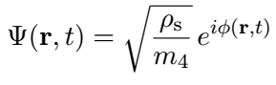
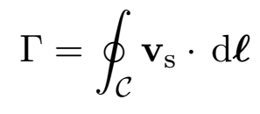
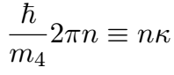
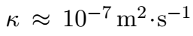
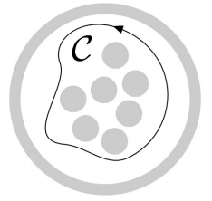
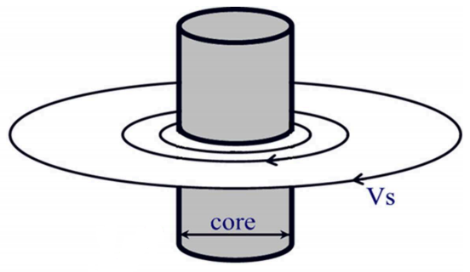
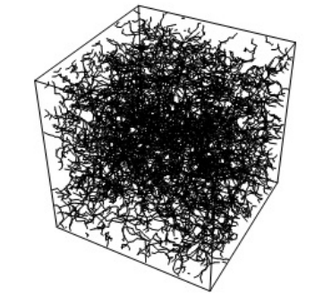
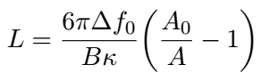
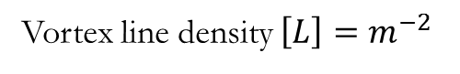
Quantum vortex model
Macroscopic wave function:
[1]
Circulation:
circulation quantum
[1]
Jakub Bahyl Mgr. Thesis Defense 5/29

Slide 6
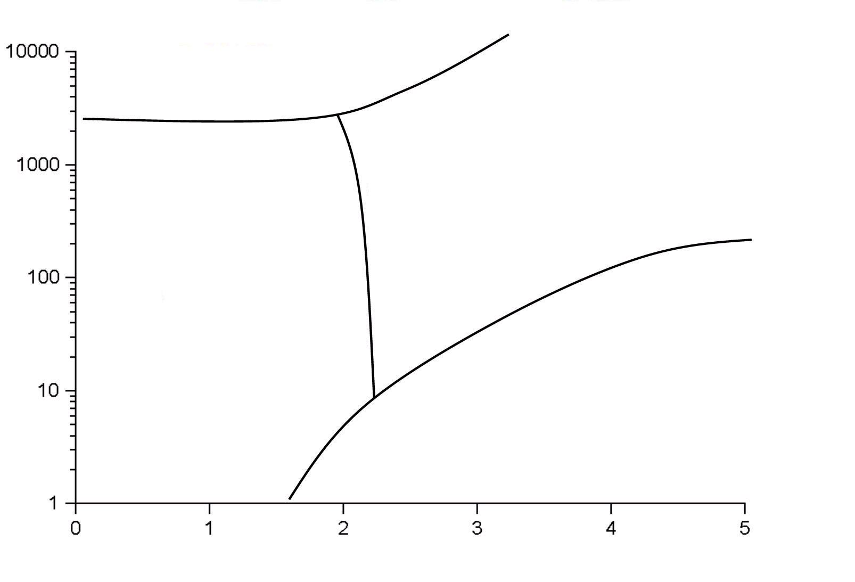
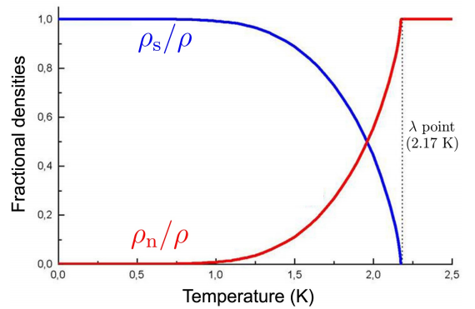
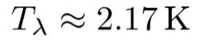
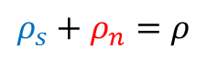
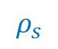
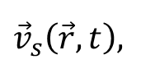
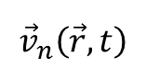
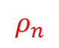
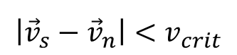
Two-fluid model
solid
liquid
P (kPa)
1 atm.
superfluid
gas
T (K)
Two independently behaving fluids:
- superfluid component
- normal component
Jakub Bahyl Mgr. Thesis Defense 3/29

Slide 7
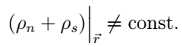
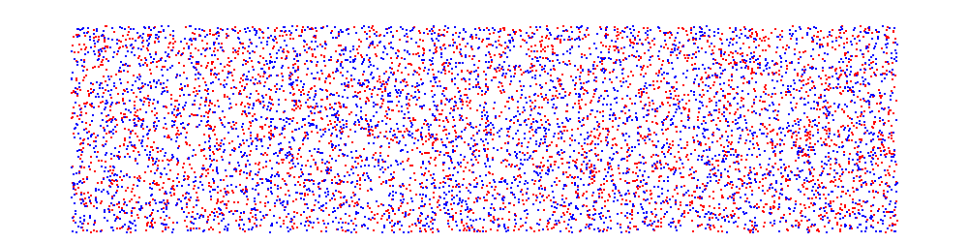
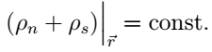
Wave processes
„First sound“ (pressure-density wave):
„Second sound“ (entropy-temperature wave):
Jakub Bahyl Mgr. Thesis Defense 4/29

Slide 8

Outline
Introduction to Superfluidity
Quantum Vortex & Two-fluid model
Filaments dynamics
Experimental Setup
Generation of Quantum Turbulence
Second Sound Sensors
Simulations
Graph model & Representation
Vortex Ring Segmentation
Results
Vortex line density & hydrodynamics
Correlations
Summary
Jakub Bahyl Mgr. Thesis Defense 6/29

Slide 9
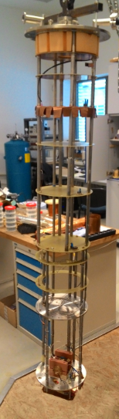
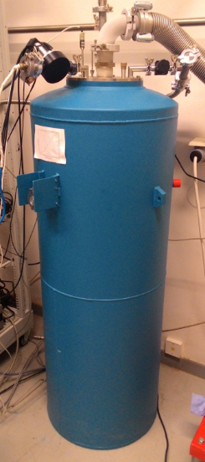
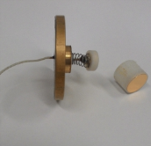
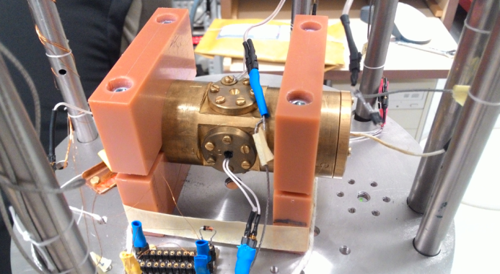
Apparatus
Jakub Bahyl Bc. Thesis Defense

Slide 10
Outline
Introduction to superfluidity
Two-fluid model & Quantum vortices
Second sound attenuation
Experimental setup
6.5 kHz quartz tuning fork
Second sound sensors
Results
Vortex line density & hydrodynamics
Correlations
Summary
Jakub Bahyl Bc. Thesis Defense

Slide 11
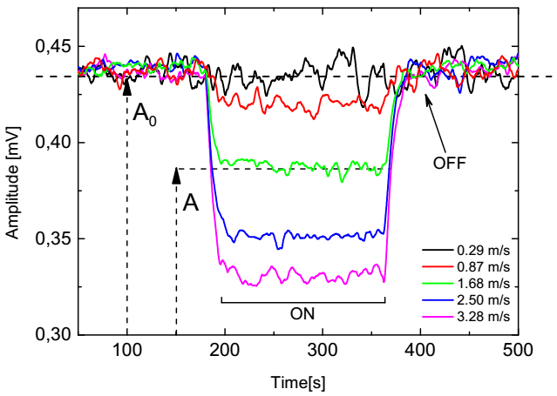
Second sound signal decrease
t = 0: Fork OFF, second sound OFF
0 < t < 180 : Fork OFF second sound ON
180 < t < 360 : Fork ON second sound ON
360 < t < 500 : Fork OFF second sound ON
500 < t : Fork OFF second sound OFF
Jakub Bahyl Bc. Thesis Defense

Slide 12
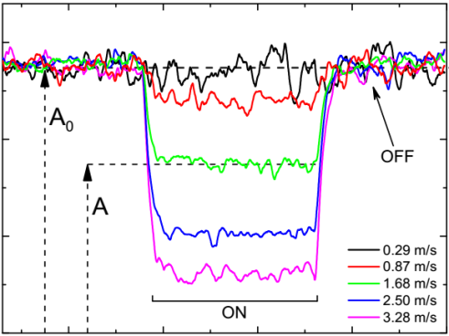
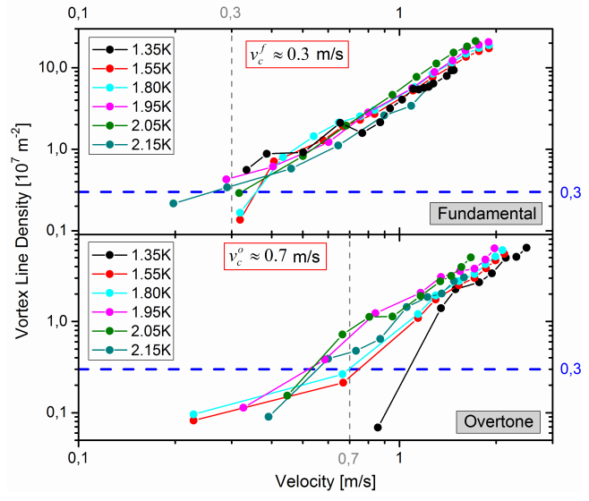
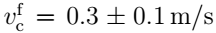
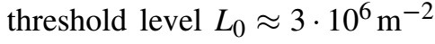
Vortex line density
Critical velocities:
Fundamental
Overtone
Jakub Bahyl Bc. Thesis Defense

Slide 13
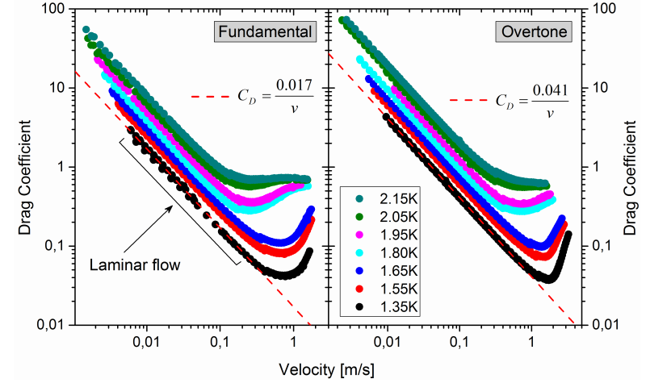
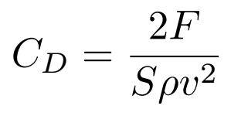
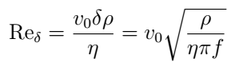
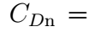
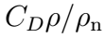
Drag coeff. against Velocity
Dimensionless quantities:
Oscillatory Reynolds number
Drag Coefficient for normal component
Jakub Bahyl Bc. Thesis Defense
Notes:
Doplnit vzorec F -> C. + Appendix slajd, kde je vysvetlené, prečo je tento Re dobrý (penetration depth).

Slide 14
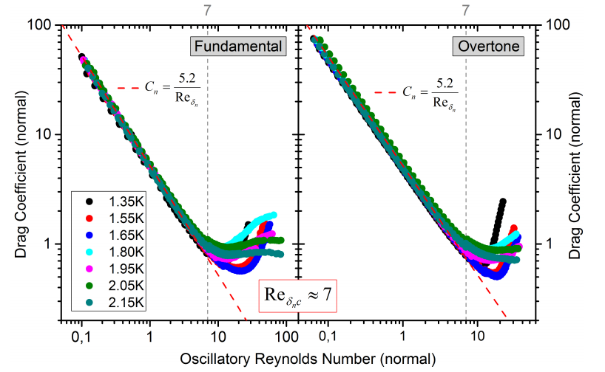
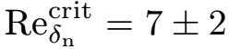
Drag coeff. (norm) vs. Oscillatory Reynolds
The same fit for both (geometrically different) situations!
Estimated critical value for Oscillatory Reynolds number:
Jakub Bahyl Bc. Thesis Defense

Slide 15
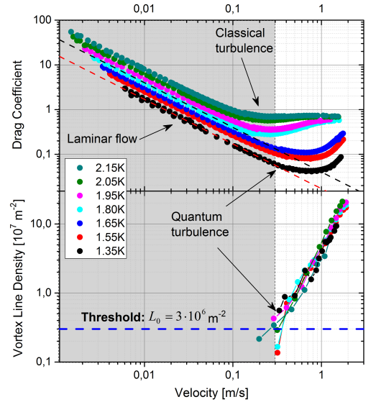
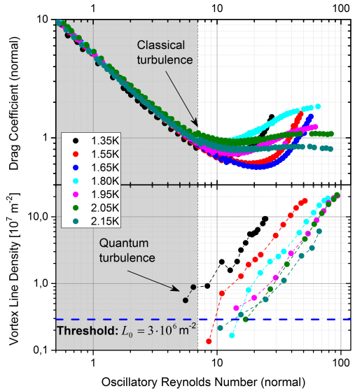
Correlations (fund.)
Jakub Bahyl Bc. Thesis Defense

Slide 16
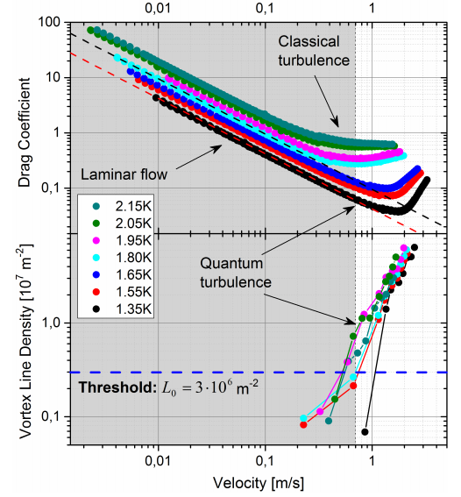
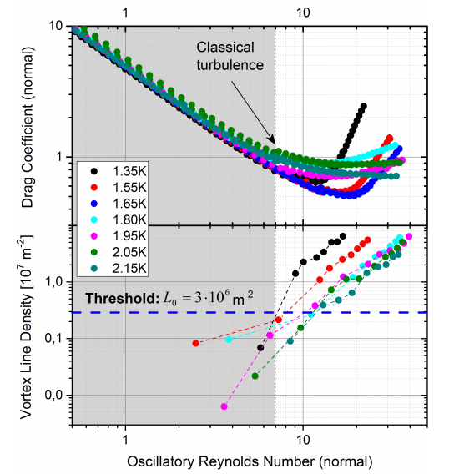
Correlations (over.)
Jakub Bahyl Bc. Thesis Defense

Slide 17
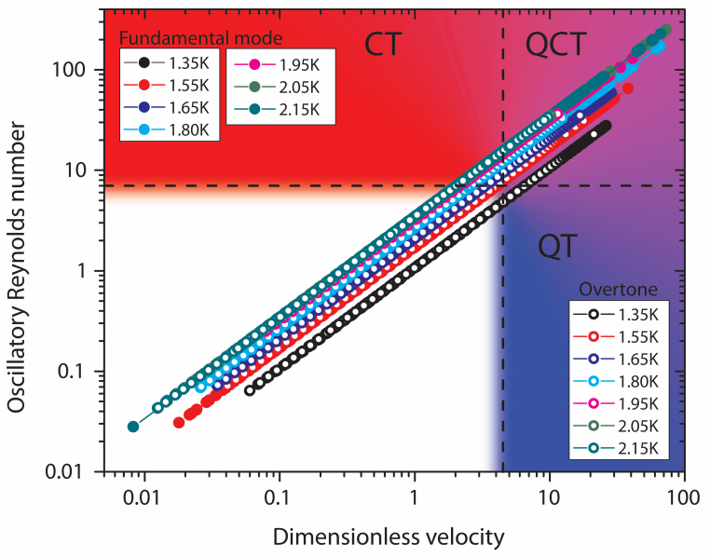
Flow phase diagram
Jakub Bahyl Bc. Thesis Defense

Slide 18
Outline
Introduction to superfluidity
Two-fluid model
Quantum vortices
Second sound attenuation
Experimental setup
6.5 kHz quartz tuning fork
Second sound sensors
Results
Summary
Jakub Bahyl Bc. Thesis Defense

Slide 19
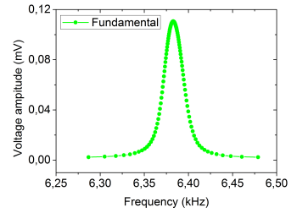
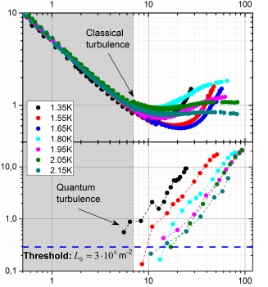
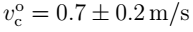
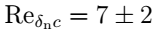

Summary
Fundamental and overtone resonance mode of submerged tuning fork in superfluid 4-He have been found.
Reliable formation of QT above (fundamental) and (overtone) was found to be temperature independent.
Onset of non-linear drag has been observed above for both fork modes.
Design of flow phase diagram, clearly showing the 1st approximation of shape of turbulence zones.
Jakub Bahyl Bc. Thesis Defense

Slide 20
Thank you for attention.
Jakub Bahyl
kubo@fks.sk
http://superfluid.cz/
Jakub Bahyl Bc. Thesis Defense

Slide 21





Appendix 1: Oscillation hydrodynamics
Extra degree of freedom (time period)
Re cannot fully describe the flow
In special case of high frequency limit, when
,
the flow velocity changes most significantly at the penetration depth scale:
oscillating plane
Jakub Bahyl Bc. Thesis Defense

Slide 22


Appendix 2: Superfluid hydrodynamics
classical fluid
thermo-mechanical coupling
counter-flow interaction
Wave equations
1. sound:
2. sound:
mutual friction
Jakub Bahyl Bc. Thesis Defense

Slide 23



Appendix 3: Second sound attenuation
dissipative
non-dissipative
Jakub Bahyl Bc. Thesis Defense

Slide 24








Appendix 4: Quartz tuning fork
Modes:
1. Fundamental
2. Overtone
Jakub Bahyl Bc. Thesis Defense

Slide 25





Appendix 5: Second sound sensor
Second sound modes:
Left: Electrical schematics. Right: Photograph of construction
Jakub Bahyl Bc. Thesis Defense

Slide 26






Appendix 6: Discussion on production of quantised vortices
Fundamental Overtone
[2]
[2]
Jakub Bahyl Bc. Thesis Defense

Slide 27

Force-velocity characteristics
Clear transition from laminar to turbulent mode
Is the turbulence classical?
Plot Drag Coeff. instead
Jakub Bahyl Bc. Thesis Defense

Slide 28


Temperature diary
Temperature range
Jakub Bahyl Bc. Thesis Defense

